Slide 1
LEVERAGING ANN FOR TARGETED DRUG SENSITIVITY PREDICTION ON GDSC DATA

Slide 2
Introduction
Cancer treatment response varies due to genetic diversity, making drug selection challenging. Traditional methods overlook individual genomic profiles, leading to inconsistent outcomes and increased side effects. This project proposes an ANN-based model trained on GDSC data to predict drug sensitivity (IC50 values), aiding oncologists in selecting the most effective treatments for personalized cancer care.

Slide 3
Problem Statement
Current cancer treatments face key challenges:
Lack of Personalization
Uncertain Drug Efficacy
High Therapy Failure Rates – Ineffective treatments increase costs and side effects.
Our ANN-based predictive model addresses these issues by leveraging genomic data to enhance precision medicine and improve cancer treatment outcomes.

Slide 4
Objectives
Merge data from the GDSC, gene expression, mutation profiles, and CNAs to enhance the accuracy and relevance of drug response predictions.
Build an ANN model to predict IC50 values based on genomic data from multiple datasets.
Develop a Flask-based interface to facilitate easy data input.
Enable users to visualize IC50 predictions along with a comparative graph for five selected drugs.

Slide 5
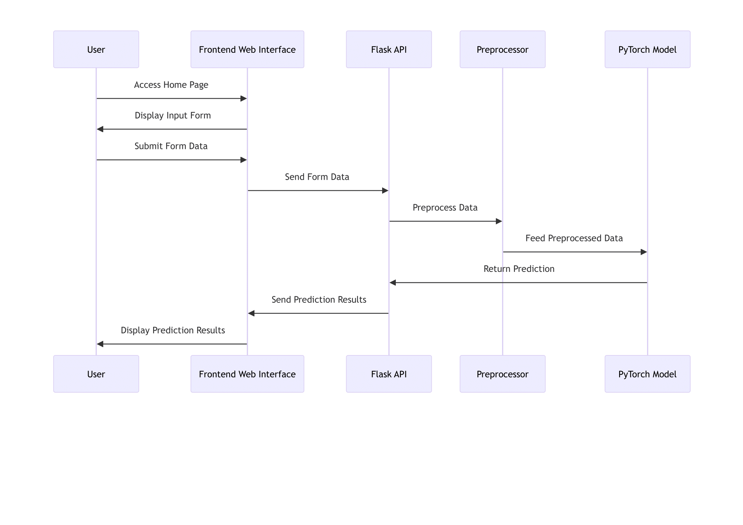
Sequence Diagram

Slide 6
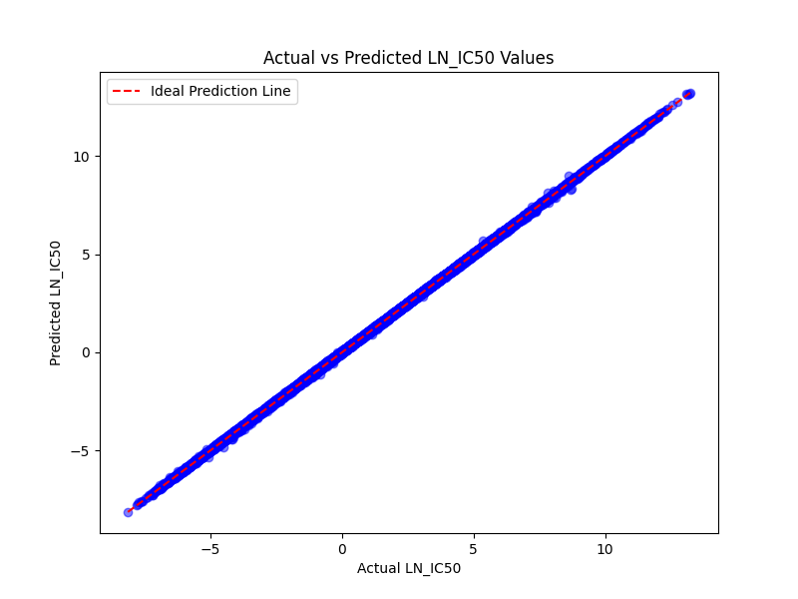
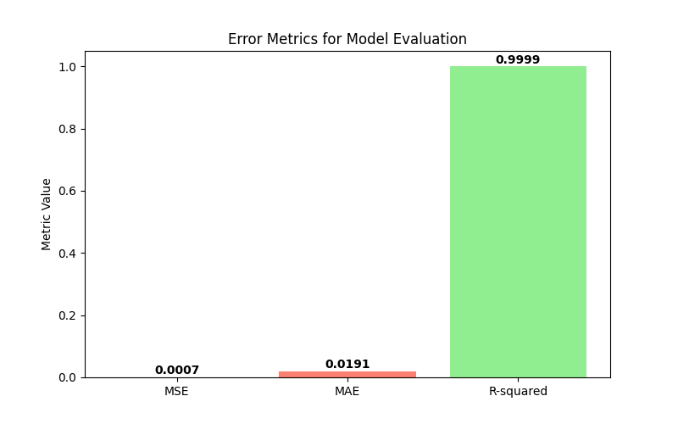
ANN Model Result

Slide 7
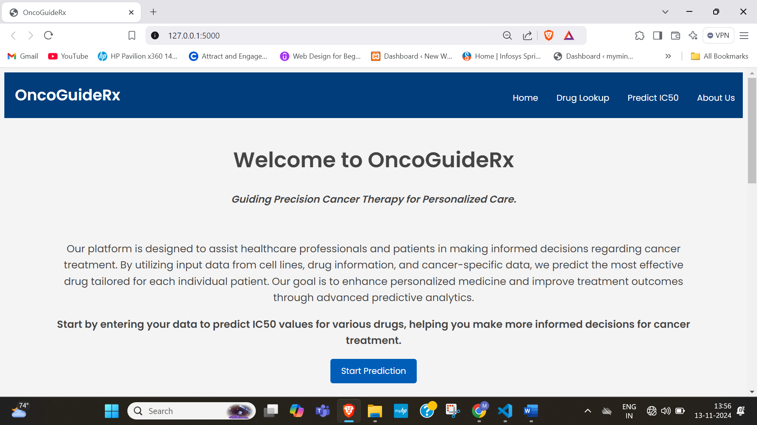
Snapshots
Home Page

Slide 8
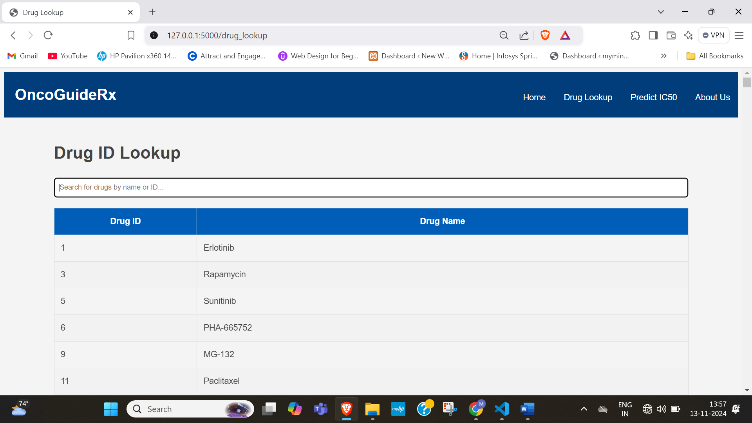
Drug Lookup Page

Slide 9
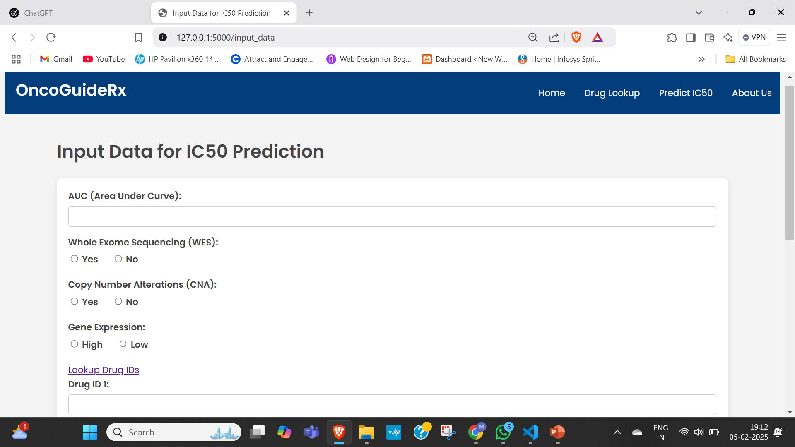
Input Page

Slide 10
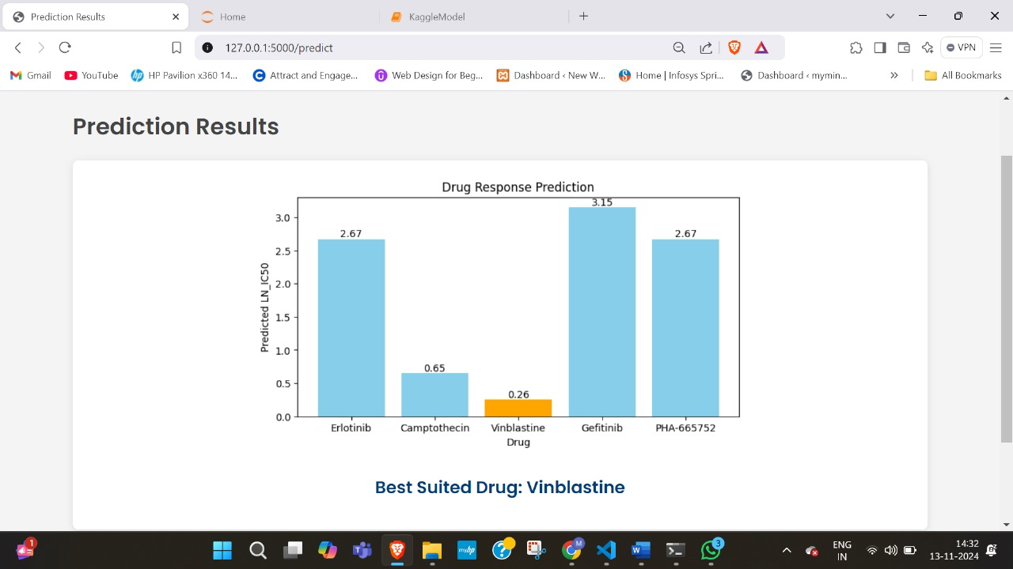
Drug Response Prediction Page

Slide 11
Conclusion
This project presents an ANN-based predictive model for drug sensitivity using genomic data from the GDSC dataset. By analyzing key genomic features, the model enhances precision medicine, helping oncologists make informed treatment decisions. Addressing challenges in personalized therapy, drug efficacy prediction, and treatment selection, this approach aims to improve cancer treatment outcomes by providing a data-driven, patient-specific drug response prediction system.

